Slide 1
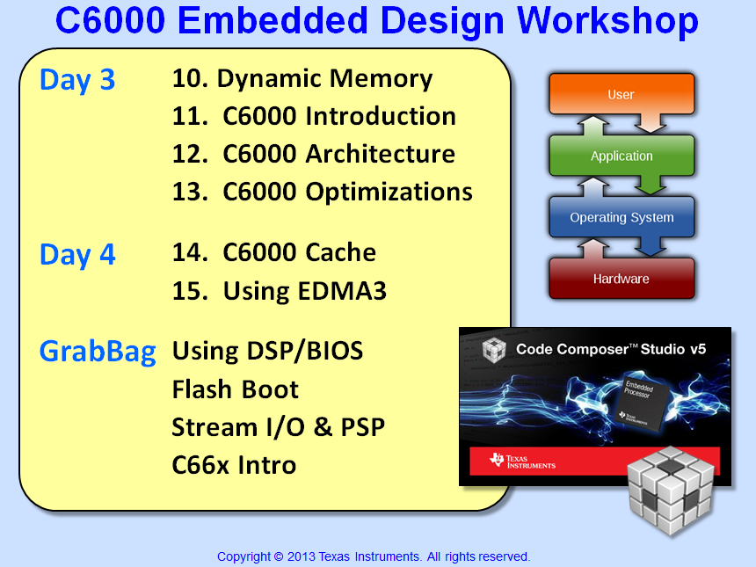

Slide 2

Fill Out the Review Forms !!
Dear Instructor,
Please do NOT forget to remind the students to fill out the review forms online.
This is not officially the END of the workshop yet, but PLEASE DO determine a TIME when they will be filled out.
We, in management, would like to see how they graded you and, based on their reviews, we will either recommend disciplinary actions or let you keep your job – one or the other…
The cold shoulder, Management

Slide 3
“Grab Bag” Topics
There is not enough time to cover them all
Which ones are most important to you? (vote for 1)
Vote | Chap # | Title | ~Time (min)
 | 16a | Intro to DSP/BIOS | 45 + 60 (lab)
 | 16b | Booting from Flash | 45 + 45 (lab)
 | 16c | Drivers – SIO/PSP/IOM | 60
 | 16d | Introduction to C66x | 75
All material is IN your student guide or \techdocs)

Slide 4


